Slide 1
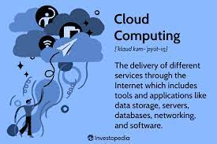


CLOUD
COMPUTING
USING
AWS

Slide 2
PROJECT
_________________
DEPLOY A STATIC WEBSITE
ON
AWS
In this project, we will learn how to create a static website and deploy it using AWS services. A static website is a site that consists of HTML, CSS, and JavaScript files, and
it doesn't require server-side processing or a database.

Slide 3
Tutorial: To Deploy a Static website
On AWS
Topics
Step 1: Create a bucket
Step 2: Enable static website hosting
Step 3: Edit Block Public Access settings
Step 4: Add a bucket policy that makes your bucket content publicly available
Step 5: deploy your website

Slide 4
Step 1: Create a bucket
The following instructions provide an overview of how to create your buckets for website hosting. For detailed, step-by-step instructions on creating a bucket, see Creating a bucket.
To create a bucket
Sign in to the AWS Management Console and open the Amazon S3 console at https://console.aws.amazon.com/s3/
Choose Create bucket
Enter the Bucket name (for example, example.com)
Choose the Region where you want to create the bucket.
Choose a Region that is geographically close to you to minimize latency and costs, or to address regulatory requirements. The Region that you choose determines your Amazon S3 website endpoint. For more information, see Website endpoints.
To accept the default settings and create the bucket, choose Create.

Slide 5
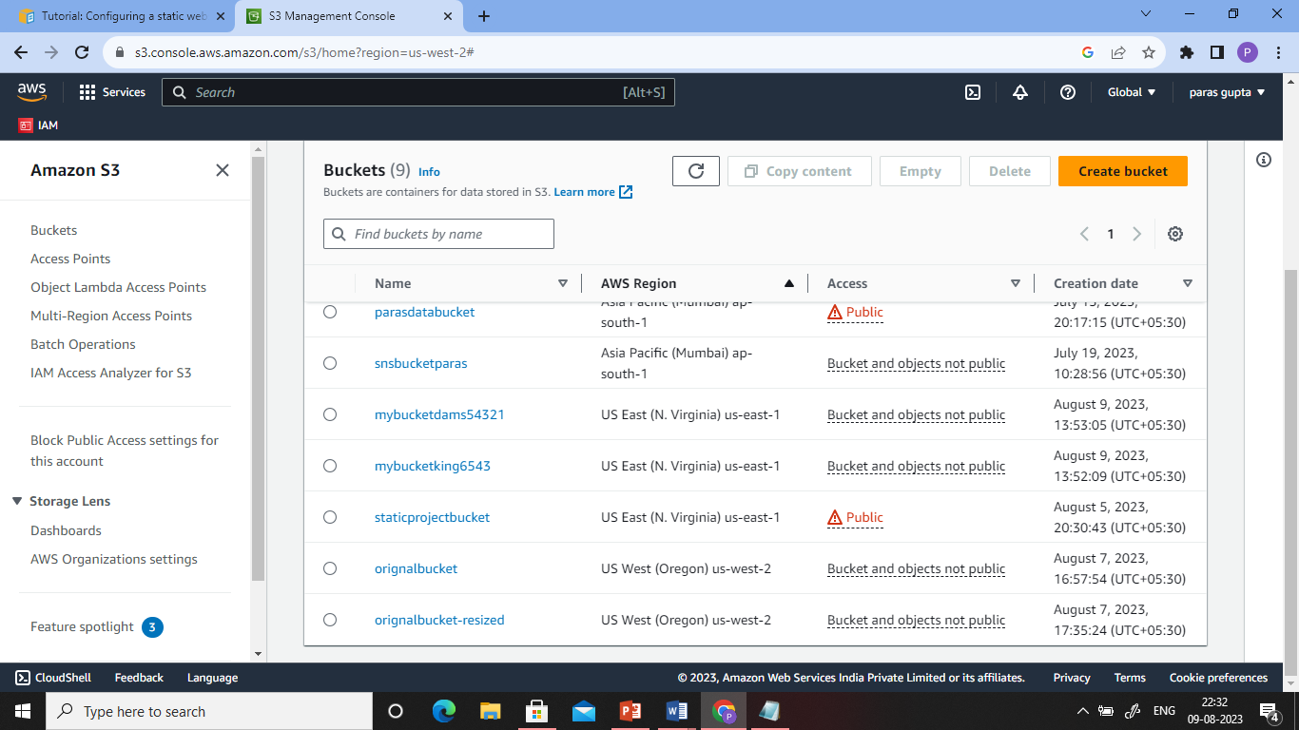

Slide 6
Step 2: Enable static website hosting
Sign in to the AWS Management Console and open the Amazon S3 console at https://console.aws.amazon.com/s3/.
In the Buckets list, choose the name of the bucket that you want to enable static website hosting for.
Choose Properties.
Under Static website hosting, choose Edit.
Choose Use this bucket to host a website.
Under Static website hosting, choose Enable.
In Index document, enter the file name of the index document, typically index.html.
The index document name is case sensitive and must exactly match the file name of the HTML index document that you plan to upload to your S3 bucket. When you configure a bucket for website hosting, you must specify an index document. Amazon S3 returns this index document when requests are made to the root domain or any of the subfolders. For more information, see Configuring an index document.

Slide 7
(Optional) If you want to specify advanced redirection rules, in Redirection rules, enter JSON to describe the rules.
For example, you can conditionally route requests according to specific object key names or prefixes in the request. For more information, see Configure redirection rules to use advanced conditional redirects.
Choose Save changes.
Amazon S3 enables static website hosting for your bucket. At the bottom of the page, under Static website hosting, you see the website endpoint for your bucket.
Under Static website hosting, note the Endpoint.
The Endpoint is the Amazon S3 website endpoint for your bucket. After you finish configuring your bucket as a static website, you can use this endpoint to test your website.

Slide 8
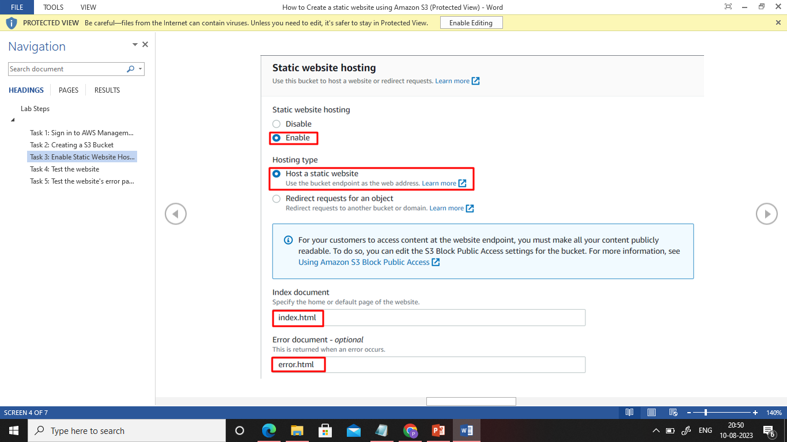

Slide 9
Step 3: Edit Block Public Access settings
Open the Amazon S3 console at https://console.aws.amazon.com/s3/.
Choose the name of the bucket that you have configured as a static website.
Choose Permissions.
Under Block public access (bucket settings), choose Edit.
Clear Block all public access, and choose Save changes.

Slide 10
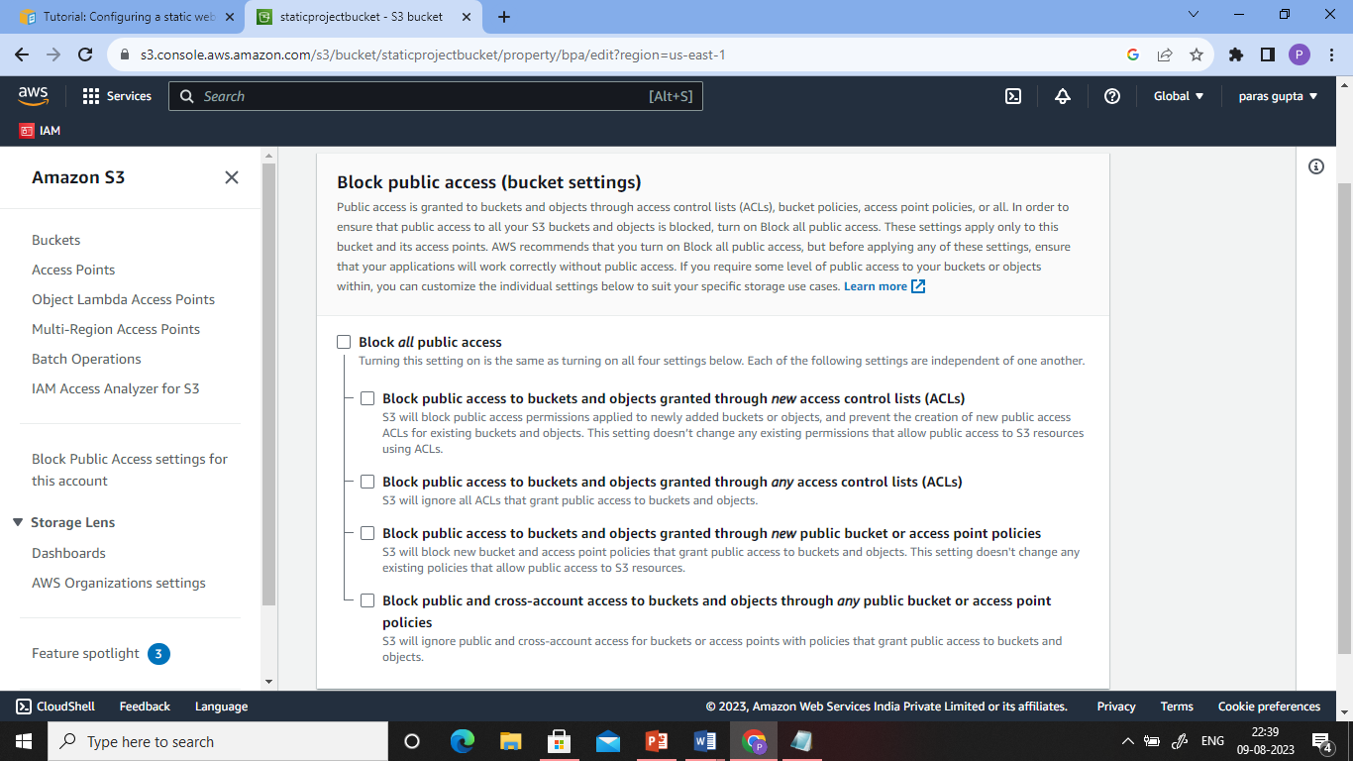

Slide 11
Step 4: Add a bucket policy that makes
your bucket content publicly available
Under Buckets, choose the name of your bucket.
Choose Permissions.
Under Bucket Policy, choose Edit.
To grant public read access for your website, copy the following bucket policy, and paste it in the Bucket policy editor.

Slide 12
{
"Version": "2012-10-17",
"Statement": [
{
"Sid": "PublicReadGetObject",
"Effect": "Allow",
"Principal": "*",
"Action": [
"s3:GetObject"
],
"Resource": [
"arn:aws:s3:::Bucket-Name/*"
]
}
]
}

Slide 13
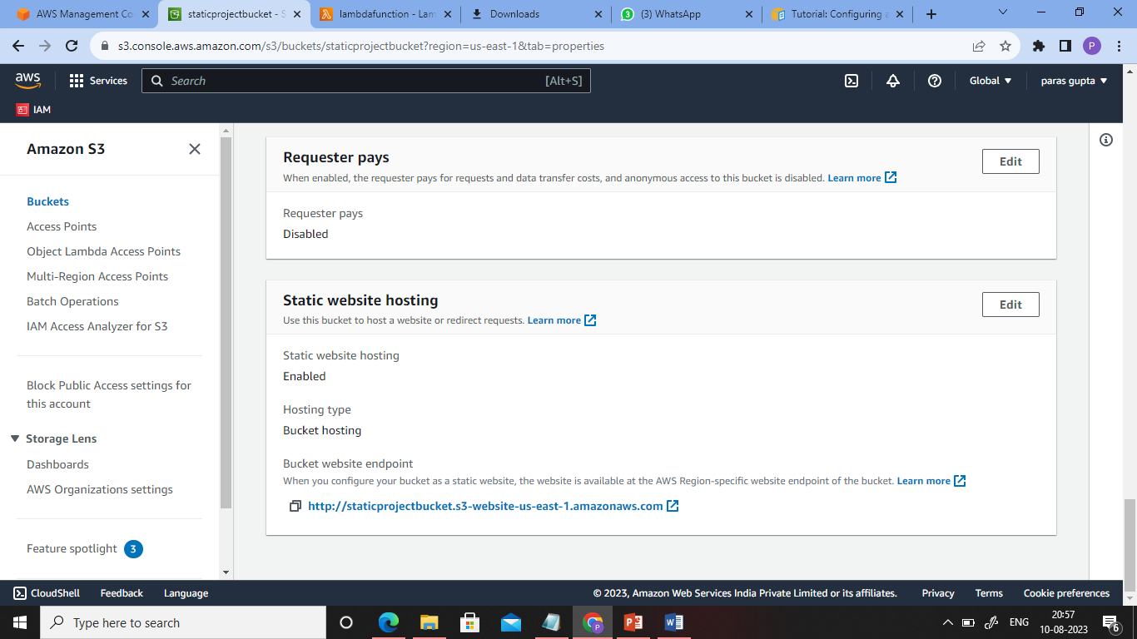
Step 5: Test the website
Now copy the static website URL (that we saved earlier) and run it in your
browser. You will be able to see the index.html file's text. A sample screenshot is
attached below:

Slide 14

Project - Serverless Image Processing
Create a serverless image processing application that automatically resizes and optimizes images
uploaded to an Amazon S3 bucket.

Slide 15
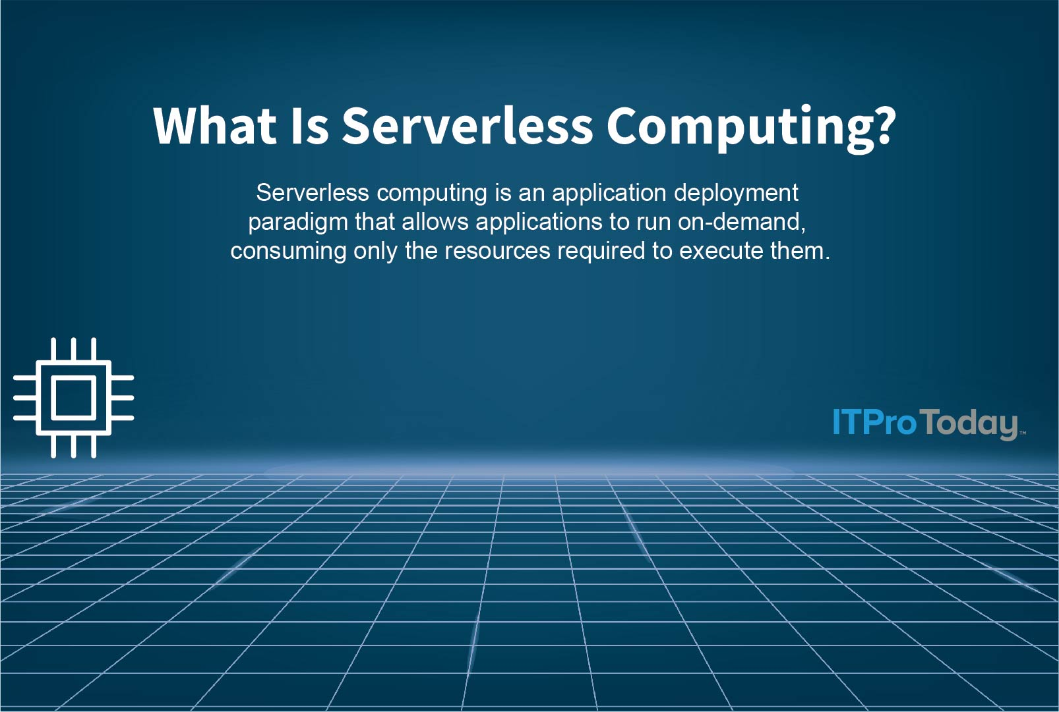

Slide 16
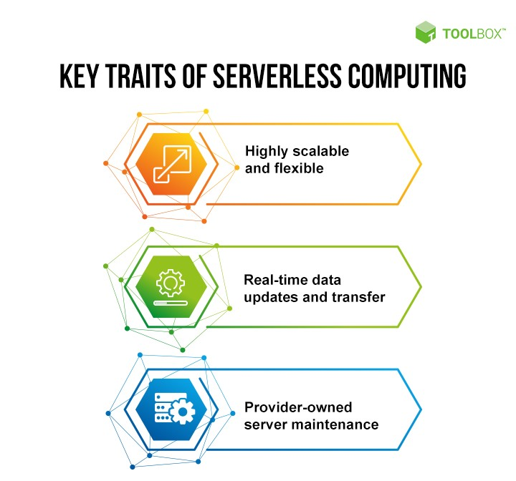

Slide 17
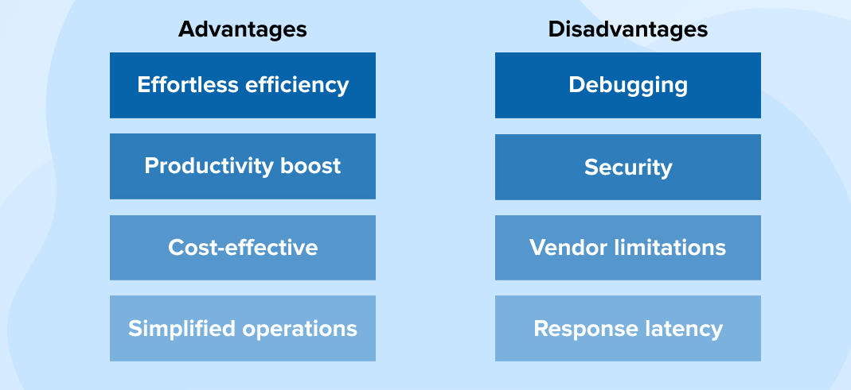
ADVANTAGES AND DISADVANTAGES
OF SERVERLESS COMPUTING

Slide 18
Task 1: Sign in to AWS
Management Console
Click on the Open Console button, and you will get redirected to AWS Console in a new browser tab.
2. On the AWS sign-in page,
• Leave the Account ID as default. Never edit/remove the 12
digit Account ID present in the AWS Console. otherwise, you
cannot proceed with the lab.
• Now copy your User Name and Password in the Lab Console to
the IAM Username and Password in AWS Console and click on
the Sign in button.
Once Signed In to the AWS Management Console, Make the
default AWS Region as US East (N. Virginia) us-east-1.

Slide 19
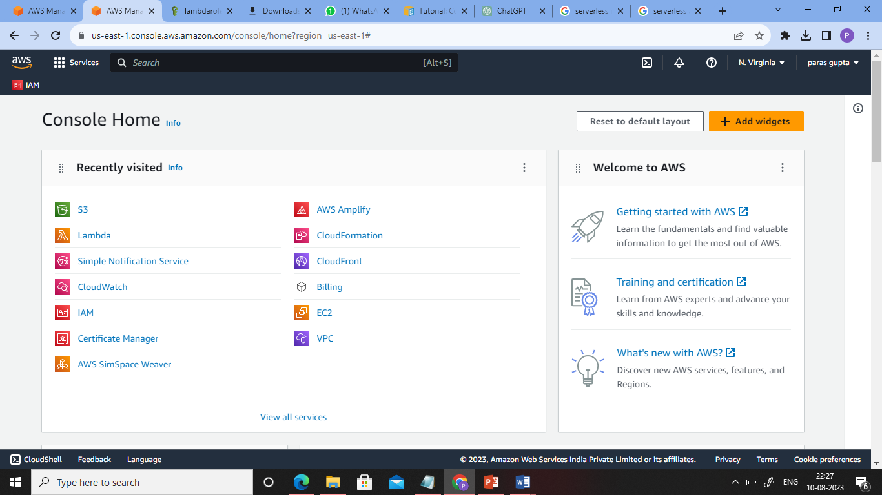

Slide 20
Task 2: Create Two Amazon S3 Buckets
In this task, we will create two AWS S3 buckets i.e the source bucket and the destination bucket by providing the required configurations like name, region etc.
Navigate to the Services menu in the top, then click on S3 in the
Storage section.
2. Click on Create Bucket button.
Bucket Name: Enter orignalbucket.
• Note: Every S3 bucket name is unique globally, so create the bucket with a
name not currently in use.
upload an image in your bucket
4. AWS Region: Select US East (N. Virginia) us-east-1

Slide 21
5. Leave other settings as default and click on the Create bucket button.
6. Once the bucket is created successfully, Select your S3 bucket.
• Click on the Copy ARN button to copy the ARN.
• Save the source bucket ARN in a text file for later use.
• arn:aws:s3:::orignalbucket
7. Create Destination Bucket
• Click on Create bucket button.
• Bucket Name: Enter orignalbucket-resized.
• Note: Every S3 bucket name is unique globally, so create the bucket with a
name not currently in use.
AWS Region: Select US East (N. Virginia) us-east-1
Leave other settings as default and click on the Create bucket button.
8. Once the bucket is created successfully,
• Click on the Copy ARN button to copy the ARN.
• Save the destination bucket ARN in a text file for later use.
• arn:aws:s3:::orignalbucket-resized.

Slide 23
Task 3: Create an IAM Role
In the left menu, click on Roles. Click on the Create
role button.
2. Select Lambda from AWS Services list.
• From Trusted Entity Type: Select AWS Service
• From Use case: Select Lambda
• Click on Next button.
• Filter Policies: Now you can see a list of policies. Here you have
to select two policies: s3 full access and AWSLambdaExecute.
• Select your policy and click on the Next button.
• Role Name: Enter lambdarole.
• Click on the Create Role button.

Slide 24
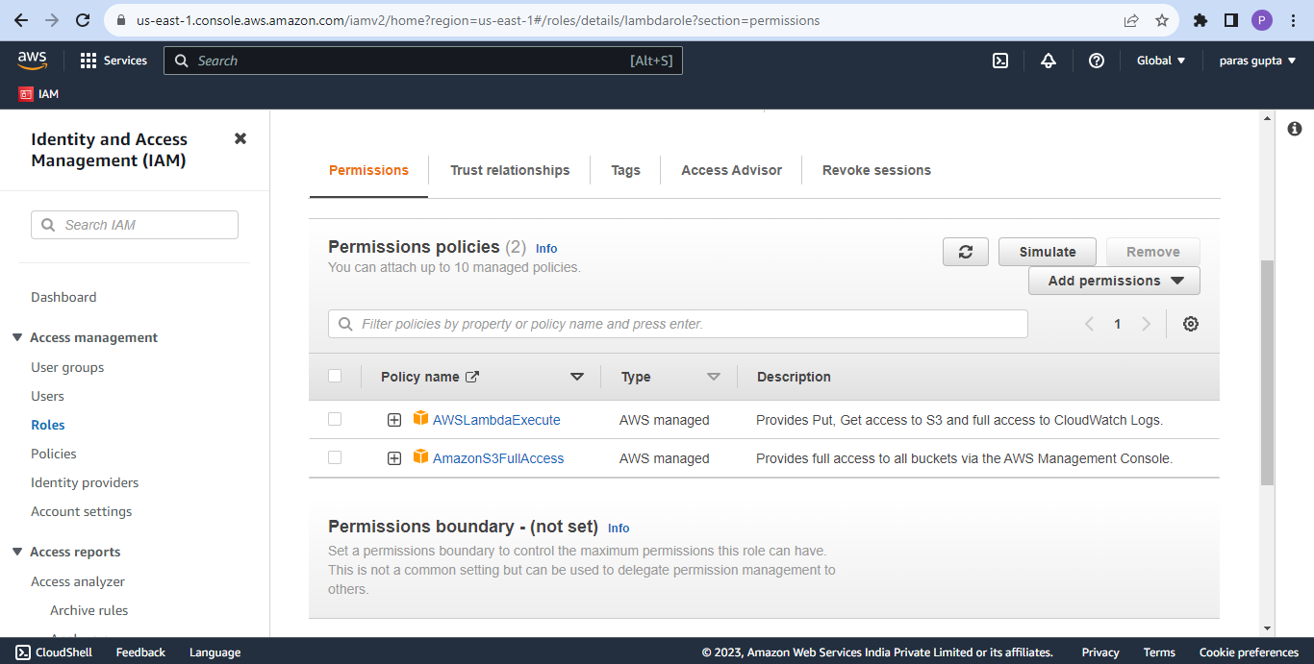

Slide 25
Task 4: Create a Lambda Function
1. Make sure you are in the US East (N. Virginia) region.
2. Go to the Services menu and click on Lambda under Compute section.
3. Click on the Create a function button.
• Choose Author from scratch
• Function name : Enter mylambdafunction
• Runtime : Select python 3.7
• Role: In the permissions section, click on Change default execution role and then select Use an
existing role.
• Existing role: Select lambdarole from the list.
4. Click on the Create function button.
5. If you scroll down a little bit, you can see the Code source section.
6. click on upload from and select .zip file
Createthumbnail handler code and download it from below link
https://s3-us-west-2.amazonaws.com/us-west-2-aws-training/awsu-
spl/spl88/2.3.prod/scripts/CreateThumbnail.zip
7. go to runtime settings and click on edit
change the handler name “CreateThumbnail.handler”.

Slide 26
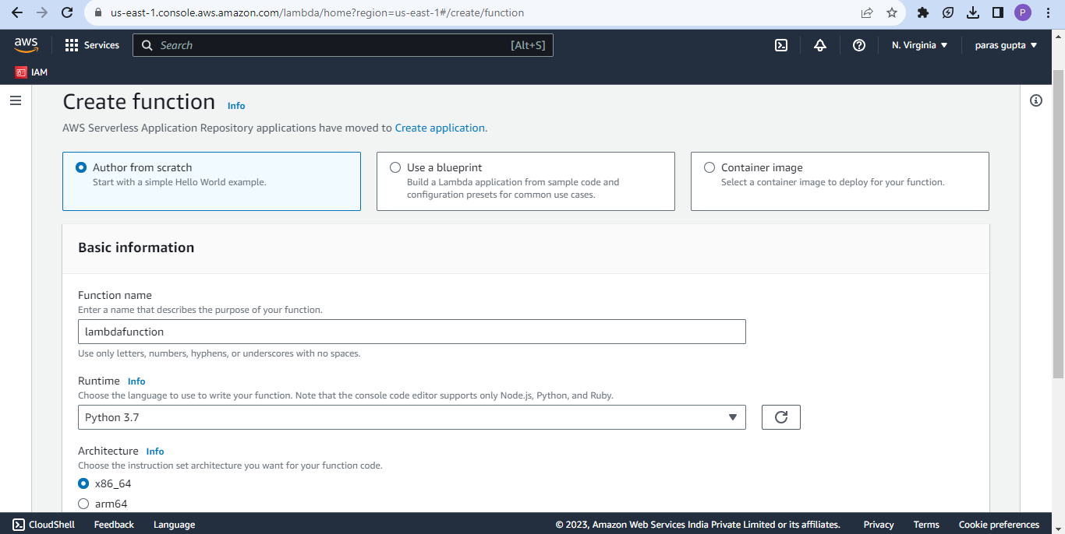

Slide 27
Task 5: Create a event
1. Go to test.
2. Create an test event.
Create the test event and modify the json code with your bucket
name and the key to your image you just upload, save and test.
4. Go and upload a second image into “originalbucket” and it will automatically be resized and moved to “orignalbucket-resized”.

Slide 28

ORIGNAL IMAGE
Image size-566 KB

Slide 29

RESIZED IMAGE
Image size-2.8 KB

Slide 30
THANK YOU

